Slide 1



Emissions
Report
Logistics without limits.

Slide 2


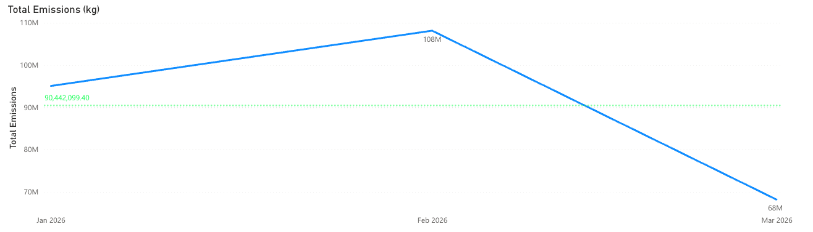
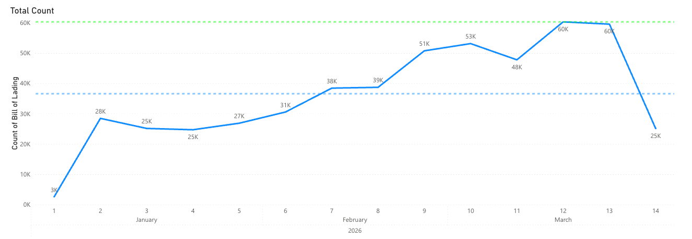

Parcel Data
2026 January 1ˢᵗ – March 31ˢᵗ
Notes:
2

Slide 3


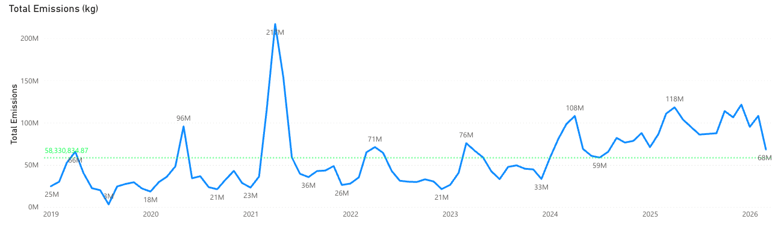
Parcel Data
Year over Year
Notes:
2

Slide 4

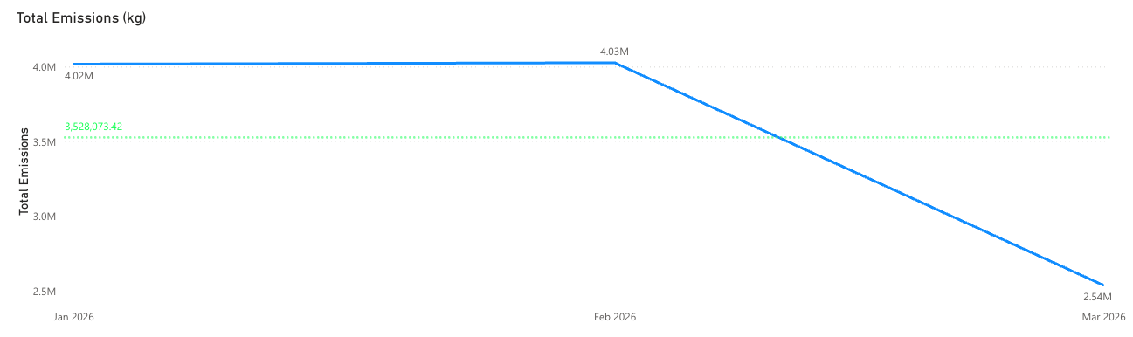


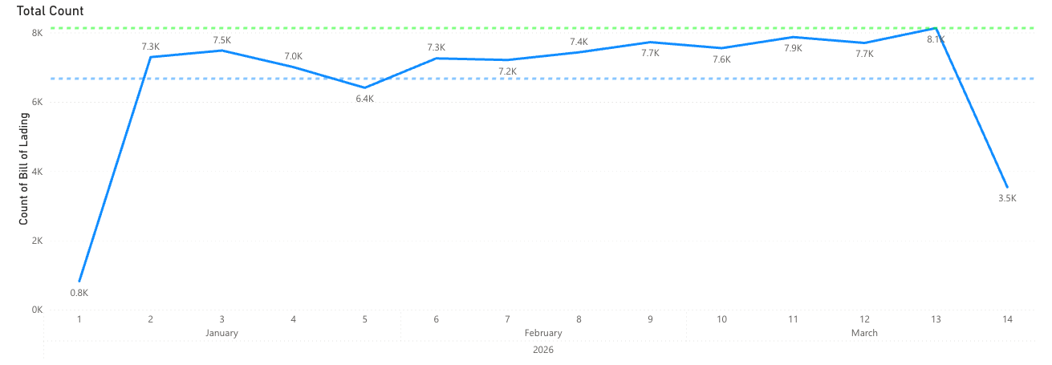
Less Than Truckload Data
2026 January 1ˢᵗ – March 31ˢᵗ
Notes:
3

Slide 5
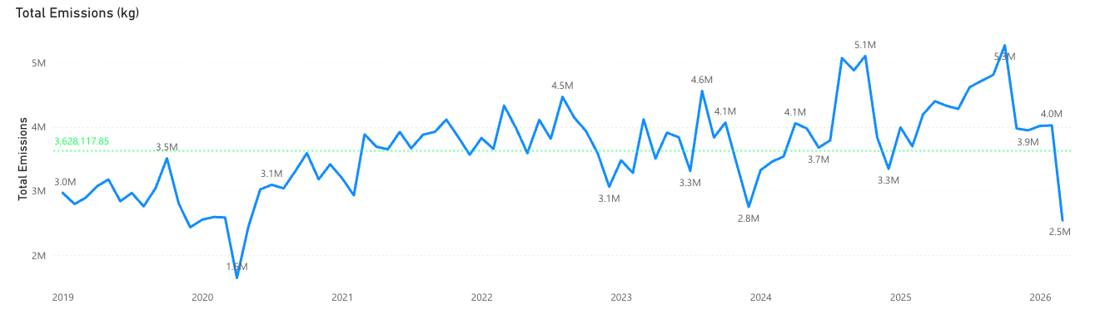


Less Than Truckload Data
Year over Year
Notes:
3

Slide 6


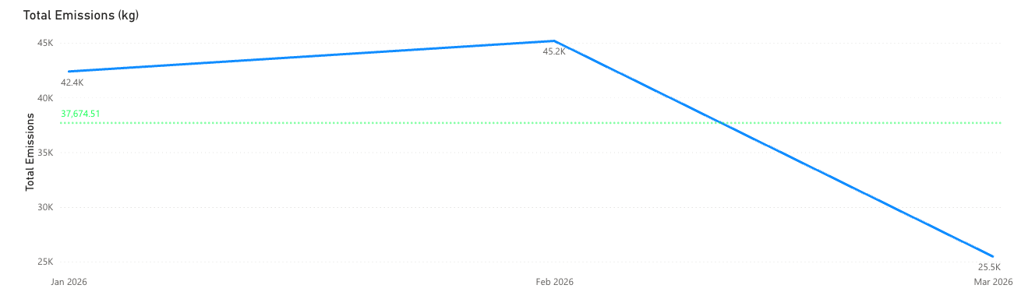
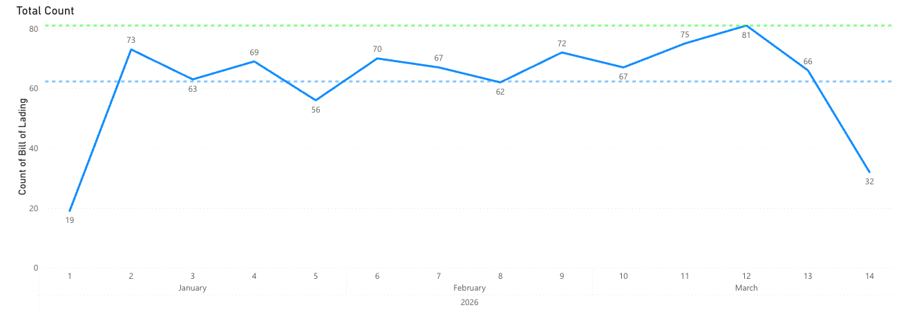
Volume Data
2026 January 1ˢᵗ – March 31ˢᵗ
Notes:
4

Slide 7

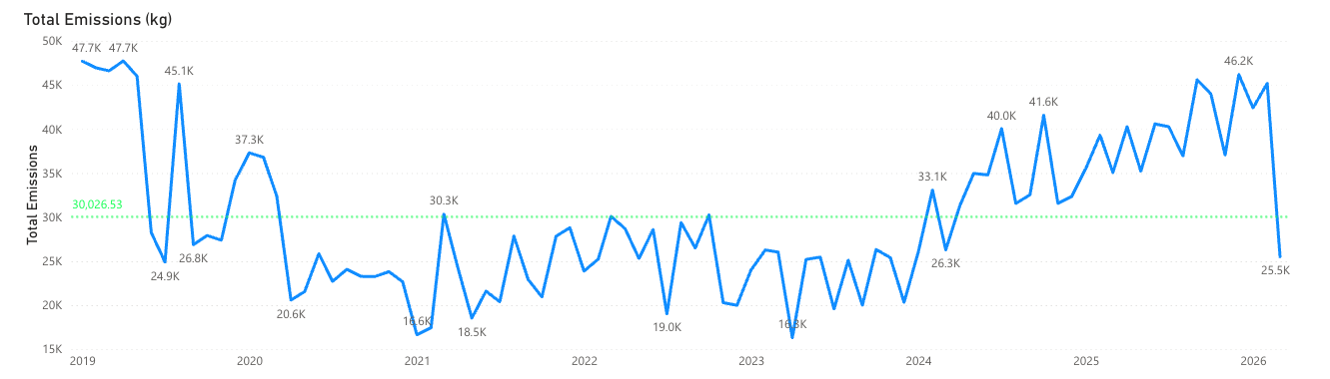
Volume Data
Year over Year
Notes:
4

Slide 8

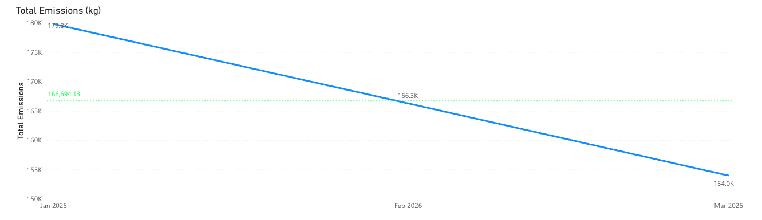
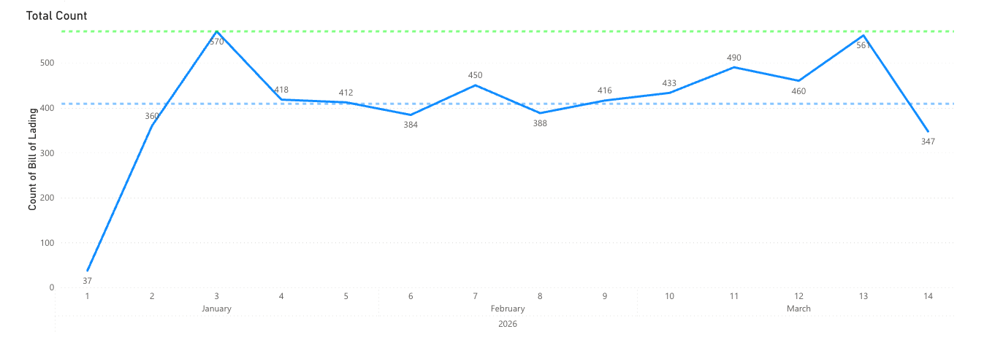
Truckload Data
2026 January 1ˢᵗ – March 31ˢᵗ
Notes:
5

Slide 9
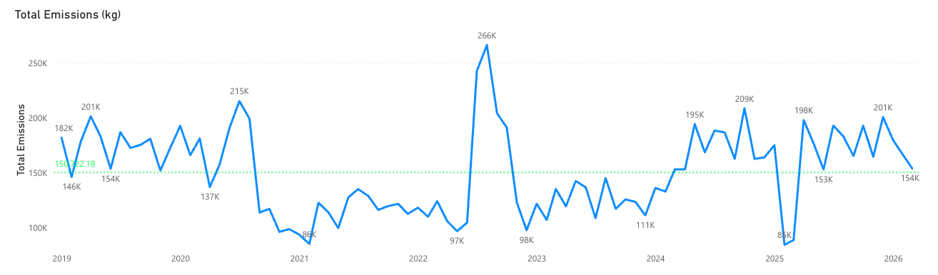

Truckload Data
Year over Year
Notes:
5

Slide 10
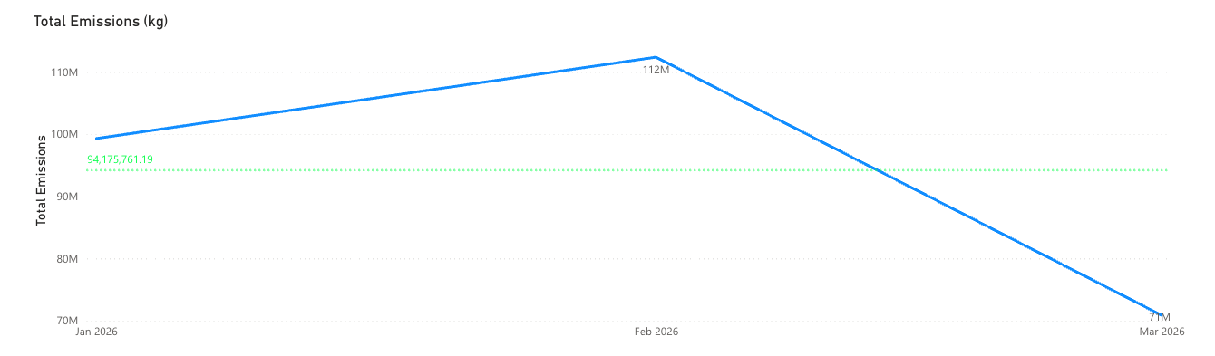
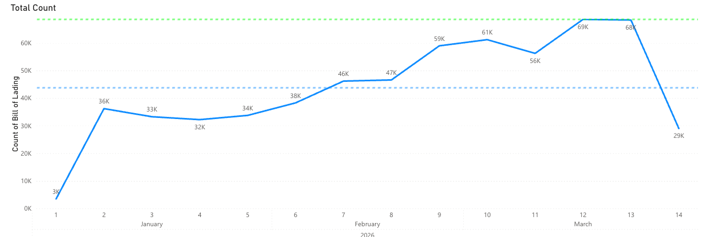

Flat World Global Solutions Data
2026 January 1ˢᵗ – March 31ˢᵗ
Notes:
6

Slide 11


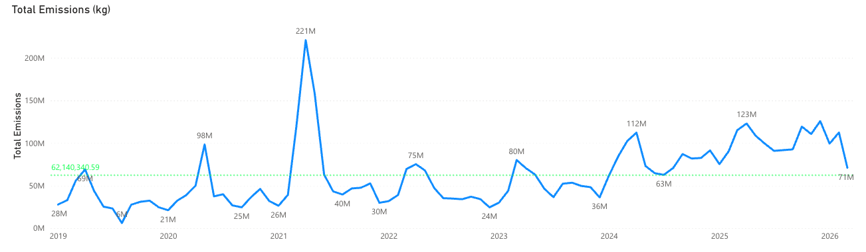
Flat World Global Solutions Data
Year over Year
Notes:
6

Slide 12











Associations

Slide 13
Logistics without limits.
(636) 339-3794 | www.flatworldgs.com
2342 Technology Drive, Suite 310, O’Fallon, Missouri 63368

